Slide 1
Employee Data Analysis using Excel
STUDENT NAME: SWETHA S
REGISTER NO: 422200925
DEPARTMENT: B.COM INFORMATION SYSTEM MANAGEMENT
COLLEGE: SHRI KRISHNASWAMY COLLEGE FOR WOMEN

Slide 2
PROJECT TITLE
SALARY AND COMPENSATION ANALYSIS THROUGH EXCEL DATA MODELING

Slide 3


AGENDA
Problem Statement
Project Overview
End Users
Our Solution and Proposition
Dataset Description
Modelling Approach
Results and Discussion
Conclusion
3/21/2024 Annual Review

Slide 4

PROBLEM STATEMENT
Introduction: In many urban areas, public transportation systems are struggling with overcrowding.
Problem Statement: The current public transportation system in City X is experiencing severe overcrowding during peak hours, leading to delays and decreased comfort for passengers. Impact: This overcrowding issue results in longer commute times, increased stress for passengers, and a decline in overall satisfaction with the public transit system. Objective: To develop and implement strategies that alleviate overcrowding during peak hours, thereby improving the efficiency and user experience of the public transportation system.

Slide 5

PROJECT OVERVIEW
Project Title: The name of the project. Project Purpose: A brief explanation of why the project is being undertaken and what it aims to achieve. Objectives: Specific goals the project intends to accomplish. These should be clear and measurable. Scope: An outline of what the project will cover, including its boundaries and limitations. Deliverables: The tangible outputs or results that the project will produce. Timeline: An overview of the project schedule, including key milestones and deadlines. Stakeholders: Individuals or groups who have an interest in the project and may be affected by its outcomes.Resources: The resources required for the project, including budget, personnel, and materials. Risks: Potential challenges or risks that could impact the project, along with strategies for managing them.
.

Slide 6

WHO ARE THE END USERS?
Definition: End users are the final recipients of the product or service. They are not involved in the development or production process but directly interact with or benefit from the outcome. Characteristics: Needs and Preferences: Their needs and preferences shape the requirements and features of the project or product. Usage Context: They use the product or service in their daily lives or work, which influences how the product should be designed or delivered. Feedback: Their feedback is essential for evaluating the product’s success and making necessary adjustments.
Example Scenarios
1.Software Development.
2.Public Transportation Project
3.Healthcare Initiative
4.Consumer product
Why Identifying End Users is Important
1.Design and Functionality
2.User experience
3.Feedback improvement.

Slide 7

OUR SOLUTION AND ITS VALUE PROPOSITION
Definition: Your solution is the product or service you are offering to address the identified problem. It outlines what you are providing and how it functions. Components to Describe:
Overview: A brief description of the solution and its primary features or functions.
Key Features: Specific characteristics or functionalities that make your solution effective.
Technology or Methodology: The underlying technology, methods, or processes that enable your solution to work.
Implementation: How the solution will be delivered or deployed to the end users.
Example:
Solution Overview: Our solution is a smart home energy management system that allows users to monitor and control their energy usage through a mobile app.
Key Features:
Real-Time Monitoring: Users can track their energy consumption in real-time.
Automated Control: The system can automatically adjust energy settings based on usage patterns and preferences.
Alerts and Recommendations: Provides alerts for unusual energy consumption and recommendations for saving energy.
Technology: The system uses IoT sensors and a cloud-based platform to collect and analyze
Data.Implementation: The system is installed by a technician, and users interact with it through a user-friendly mobile app.

Slide 8
Dataset Description
Components of a Dataset Description
Title: The name of the dataset.
Overview: A brief summary of what the dataset contains and its purpose.
Source: Where the dataset originates from, including any organizations or databases that provided it.
Data Collection: How the data was collected, including methodologies, tools, and processes used.
Content:
.Attributes/Features: A list of the variables or columns in the dataset, along with descriptions of each.
.Data Types: The type of data for each attribute (e.g., numerical, categorical, text, date).
.Sample Data: Example entries from the dataset to illustrate the data structure.
Size and Scope:
.Number of Records: Total number of rows or instances in the dataset.
.Number of Attributes: Total number of columns or features.
Quality and Completeness:
.Missing Values: Information on any missing or incomplete data and how it’s handled.
.Data Accuracy: Details on the accuracy and reliability of the data.
Usage and Applications: How the dataset can be used, including potential applications and analyses.
Access and Licensing: Information on how to access the dataset and any licensing or usage restrictions.
Updates and Versioning: Details on how often the dataset is updated and the version history if applicable.

Slide 9

THE "WOW" IN OUR SOLUTION
Innovation: Introduce a novel approach or technology that sets your solution apart from others.
User Experience: Ensure that your solution is not only functional but also user-friendly and intuitive, making the user's experience smooth and enjoyable.
Value: Provide significant benefits or solve a problem in a way that offers exceptional value, whether through cost savings, efficiency, or enhanced functionality.
Design: Incorporate aesthetically pleasing or highly functional design elements that catch the eye and make the solution stand out.
Performance: Deliver outstanding performance, reliability, or speed that exceeds industry standards or user expectations.
Personalization: Tailor the solution to meet individual needs or preferences, creating a sense of personalization and relevance.
Scalability: Offer a solution that can grow and adapt with the user's needs, demonstrating forward-thinking and long-term value.
Impact: Show how your solution creates a meaningful difference or positive change, whether for individuals, businesses, or society as a whole.
3/21/2024 Annual Review
9

Slide 10
MODELLING
Tips for Creating a "Wow" Factor in Modeling:
Clarity: Ensure that your model is easy to understand and interpret, even for those unfamiliar with the subject.
Accuracy: Validate your model to ensure it reflects real-world conditions and produces reliable results.
Innovation: Incorporate advanced techniques or unique approaches to stand out from traditional methods.
Interactivity: Allow users to interact with the model for a more engaging and insightful experience.
Visualization: Use effective and visually appealing ways to present the model’s results, making it easier to grasp complex information.
Real-world Application: Demonstrate how the model applies to practical scenarios and delivers tangible benefits.
10

Slide 11
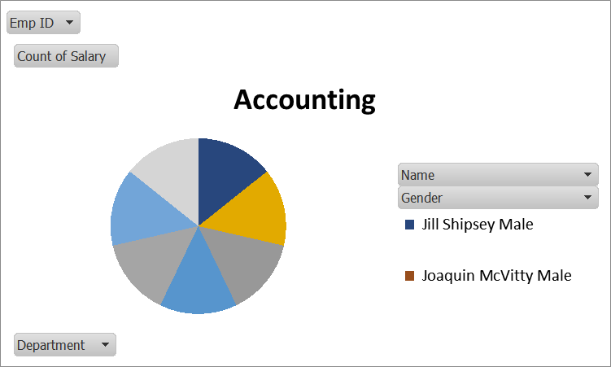
RESULTS
11

Slide 12
conclusion
"In conclusion, a thorough review of our employee salary structure reveals that while our base salaries are competitive within the industry, there are opportunities to enhance our compensation package to better align with market standards and address internal equity concerns. This is crucial for maintaining high employee satisfaction and ensuring our organization remains attractive to top talent.To address these findings, I recommend implementing a revised salary adjustment plan, increasing transparency in compensation discussions, and establishing a regular review process. By balancing competitive compensation with our financial constraints and strategic objectives, we can improve employee retention, satisfaction, and overall organizational performance. Continuous evaluation and adaptation will be key to sustaining these improvements and aligning our salary structure with our long-term goals."

